Slide 1
Welcome Back!
Come in, sit down, stretch, and get to work on this:
Make a new Javascript file: app.js (or main.js or whatever you want to call it) in your project folder
Add this code to your js (javascript) file:
Add the appropriate tags in your index.html to add the script to your page.
Enjoy your new editable page!
The current page we’ve been working on is (and will always be) at bit.ly/hackduke15app
document.body.contentEditable = 'true';
document.designMode = 'on';
alert('Page editing enabled!');
Notes:
0-10

Slide 2
WebDev III
Return of the Developer
Notes:
10-12: Talk a bit about how this course goes from simple to intermediate topics. It’ll teach people who have never done this how to get started, and show those familiar with the concepts great ways of working and explain the flow. Take questions.

Slide 3
Review!
Tag to hold a news story?
Selector to pick all p tags inside any divs with class ‘coolio’?
How to add an image to a page?
How to add a background image to an element?
What’s the difference between block and inline?
What does absolute positioning do?
Notes:
Talk about why we chose those programs. Talk about the strategy of flipped classroom style

Slide 4
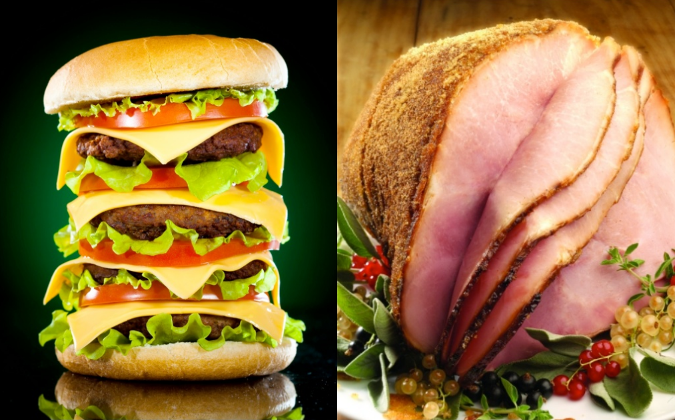
JavaScript (ECMAScript)
What is it?
“JavaScript is to Java as hamburger is to ham.” - John Resig
Almost everything is an “Object”
Dynamic Typing
When do I use it?
To interact with users
To update information on a page
To write a server
Anything you can’t do with HTML/CSS
Reference: bit.ly/js-reference
Notes:
Talk about why we chose those programs. Talk about the strategy of flipped classroom style

Slide 5
Objects: what are they?
They have attributes (also called properties or values).
They have scopes.
Let’s make some! (CONSOLE.LOG WILL BE YOUR BEST FRIEND)
var myThing = {};
myThing.isCool = true;
myThing.becomeCool = function() {
myThing.isCool = true;
}
var myThing = {;
isCool: true,
becomeCool: function() {
myThing.isCool = true;
}
}
function makeThing() {
var myThing = true;
}
console.log(myThing); //ERROR

Slide 6
Control
if {then}
for (var i in obj) {}
while() {}

Slide 7
What can you do?
The DOM

Slide 8
What you know
The Document Object Model (DOM)
API for structure of page
Attributes, comments, nodes, styles are accessible objects
Events can be caught and created

Slide 9
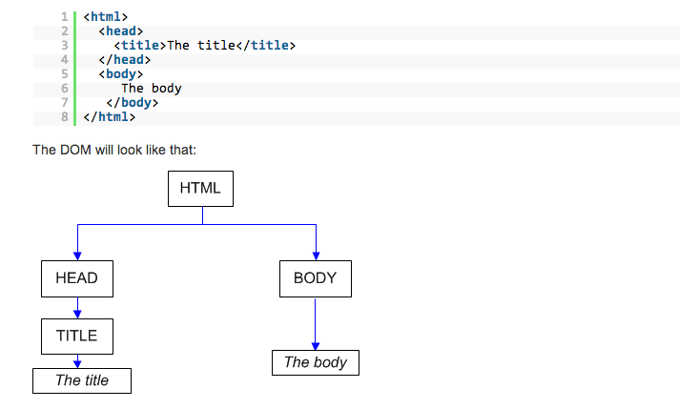
An example

Slide 10
What you know
Functions of the DOM:
Select elements using CSS selectors
Create new elements
Add/modify attributes
Listen to events

Slide 11
What you know
Functions on the DOM:
(document || HTMLElement).querySelector (document || HTMLElement).querySelectorAll
document.createElement
HTMLElement.style
HTMLElement.getAttribute HTMLElement.setAttribute
EventTarget.addEventListener

Slide 12
Here’s how powerful it is
var titleLinks = document.querySelectorAll('a.title');
var data = Array.prototype.map.call(titleLinks,
function(el) {
return { link: el.href, content: el.innerText };
});
var link = document.createElement('a');
var dataBlob = new Blob([ JSON.stringify(data, null, ' ') ], { type: 'application/json' });
link.href = URL.createObjectURL(dataBlob);
link.target = '_blank';
link.setAttribute('download', 'data.json');
link.click();

Slide 13
What can you do?
Event Loop

Slide 14
What you don’t know
JavaScript is single threaded.
concurrency is handled by an “event loop”
The loop queues messages and executes associated functions.
while (messageQueue.waitForMessage()) {
messageQueue.processMessage();
}

Slide 15
What you may not realize
Messages are:
events
timeouts/intervals
interpreting a script tag
Message handler “run to completion”

Slide 16
What you don’t know
What is a tick?
When the current message on the queue is processed, and the next is taken up.
This will occur when the stack is empty.

Slide 17
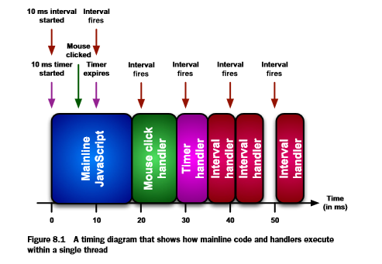
The Event Loop Queue

Slide 18
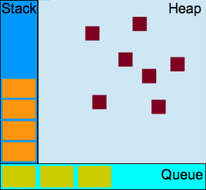
Memory in JS engines
Stack - Functions
Heap - Objects
Queue - Events

Slide 19
What you may not realize
Consequences of the event loop:
Writing long-running blocking code is bad!
Blocking code is the code that is executed sequentially with a message function.

Slide 20
Writing non-blocking code
Use setTimeout with long-running, blocking code.
var i = 0, current_position = 0;
var timeout = setTimeout(function work() {
current_position += 100; for (i; i < current_position; i++) {
// heavy work here
}
timeout = setTimeout(work, 0); }, 0);

Slide 21
setTimeout Considerations
setTimeout will try to run with the specified delay.
Too many messages in the queue message will delay it.

Slide 22
Writing non-blocking code
Alternatively, setInterval can be used:
var i = 0, current_position = 0;
var data = new Array(10000);
var interval = setInterval(function work() {
current_position += 100; for (i; i < current_position; i++) {
if (i > data.length - 1) {
clearInterval(interval);
break;
}
// heavy work here
} }, 500);

Slide 23
setInterval Considerations
Intervals may end up executing back to back.
Putting in an interval that is 0ms will be very bad news.
Most ticks last at least 4ms.

Slide 24
What can you do?
Events

Slide 25
What you don’t know
Events are just another message type on the event loops queue.
For events there are:
emitters - create the message
consumers - react to the message

Slide 26
DOM Events
There are two possible ways a DOM event can be emitted:
By user interaction
User clicks button
By the programmer
var btn = document.createElement(‘button’);
btn.click();

Slide 27
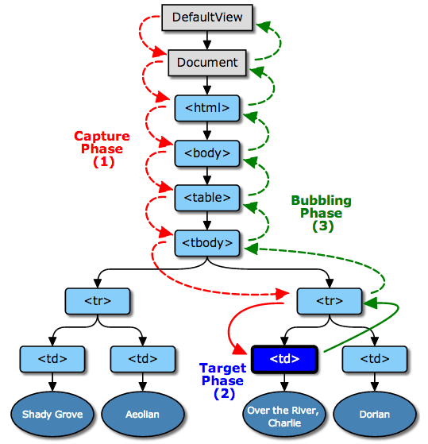
Event Emission
Three Phases:
Capture
Target
Bubbling

Slide 28
DOM Events
There are three possible ways a DOM event can be consumed:
from HTML element inline
<button onclick="func()"></button>
from EventTarget in JS
btn.onclick = function() {}
by listening to EventTarget
btn.addEventListener("click", func)

Slide 29
Event Consumption
Suppose we want to turn a m*m table cell yellow when it is clicked:
var cells = document.querySelectorAll(‘td’);
var makeYellow = function(){
this.style.backgroundColor = ‘yellow’;
};
for (var n = 0; n < cells.length; n++){
cells[n].addEventListener(‘click’, makeYellow):
}

Slide 30
Event Consumption
We just created m² event listeners.
Instead, let’s use event bubbling to delegate:
var table = document.querySelector(‘table’);
table.addEventListener(‘click’,
function(event){
var target = event.target;
if (target.tagName === ‘TD’) {
target.style.backgroundColor = ‘yellow’;
}
});

Slide 31
Custom Events
What if you wanted to make your own event?
Decide a name for the event.
“gameOver”
Choose a DOM element that will emit the event.

Slide 32
Custom Events
var canvas = document.querySelector("canvas");
var eventOne = new CustomEvent("gameOver", {
detail: {
score:50
},
bubbles: true
});
canvas.dispatchEvent(eventOne);

Slide 33
Review Time again!
Likes | Dislikes
Ordering food at 3 AM from bed Pretending I’m flying an airplane The 3D printers in the hall | Java (language and coffee, but the island is okay) Actually flying an airplane The 3D Printers in the hall
Notes:
12-13: Talk about self

